Slide 1
Graduation Requirements and Course Selection
2021-2022
Parent Informational Session
January 20, 2021

Slide 2
School Counseling Department
Ms. Kandetzke: School Counseling Director & 10th grade School Counselor
Ms. Howard: 11th & 12th last names A – K
Ms. Barreras: 11th & 12th last names L – Z
Ms. Francillon: Grade 9
Ms. Plass: Advanced Academics Coordinator
Ms. Sterling: ESOL Coordinator
Ms. T. Scott: Student Assessment Specialist

Slide 3
Graduation Requirements - Subjects
English: 4 credits
Mathematics: 4.0 credits
  Algebra 1, Geometry, and 2 additional math courses
Science: 3 credits
  Biology and 2 additional science courses
Social Studies
  World History (1.0), US History (1.0), Government (.50) and Economics (.50)
Physical Education: 1 credit
  Personal Fitness .50 credit
  Physical Education .50 credit
Arts: 1 credit
  Performing/Practical/Fine/Speech/Debate
Electives: 8 credits
Total: 24 credits

Slide 4
Graduation Requirements –Assessments
State Assessments
  Passing score on the Grade 10 FSA English/Language Arts (ELA) statewide, standardized assessment or concordant score
  Passing score on the Algebra 1 EOC or concordant score

Slide 5
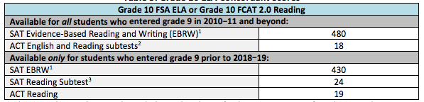
Graduation Requirements –Concordant Scores

Slide 6
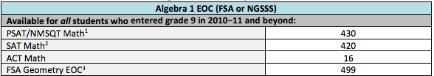
Graduation Requirements –Concordant Scores

Slide 7
Graduation Requirements –Additional
Online Course
Grade Point Average
  Cumulative, unweighted GPA of 2.0 on a 4.0 scale
Service Hours: 40 hours

Slide 8
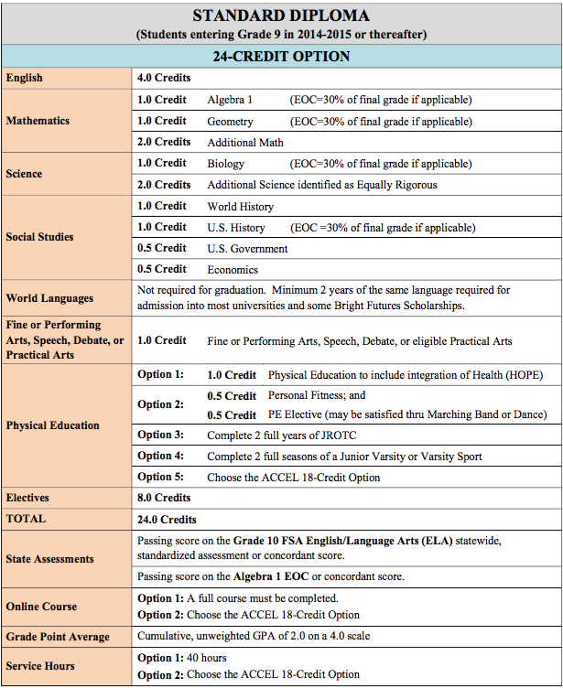
Graduation Requirements –
Chart

Slide 9
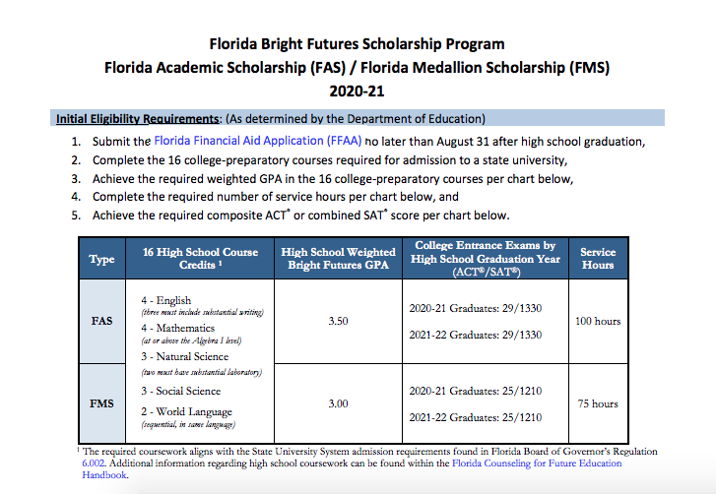
Bright Futures www.floridastudentfinancialaidsg.org

Slide 10
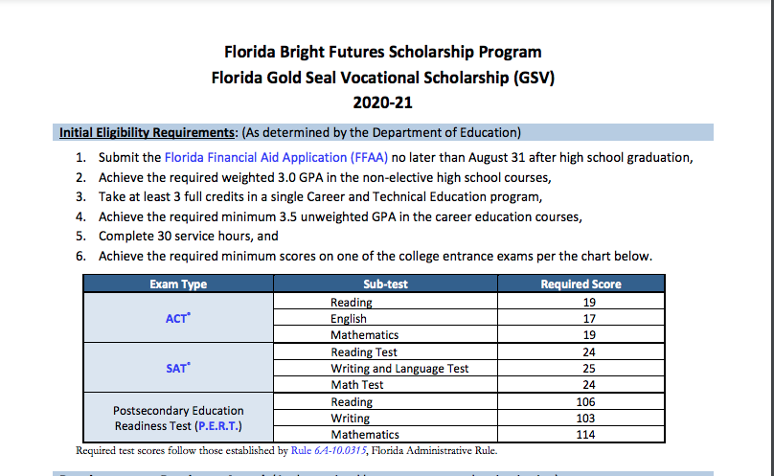
Bright Futures www.floridastudentfinancialaidsg.org

Slide 11
Course Selection Process for 2021-2022
Students should speak with their English, Math, Science, and Social Studies teachers for recommendations
  11th by January 27th
  10th by February 1st
  9th by February 10th
Students should review Course Selection with their parents
Students will complete the electronic Course Selection card during Study Hall
  Only 1 submission is allowed
  Must complete and submit the form in one sitting.
Course Selection will not be finalized until the student meets with a School Counselor

Slide 12
Course Selection with School Counselors
Current 11th grade students: February 1 – 8
Current 10th grade students: February 8 – 17
Current 9th grade students: February 18 – March 2

Slide 13
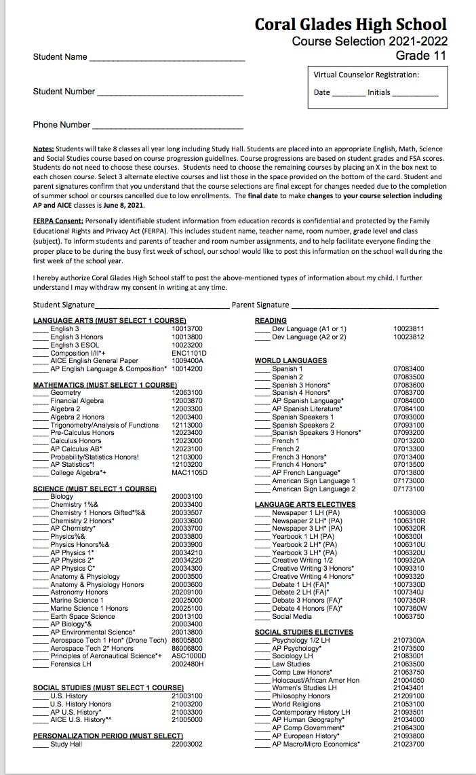
11th Grade Course Card – Example

Slide 14
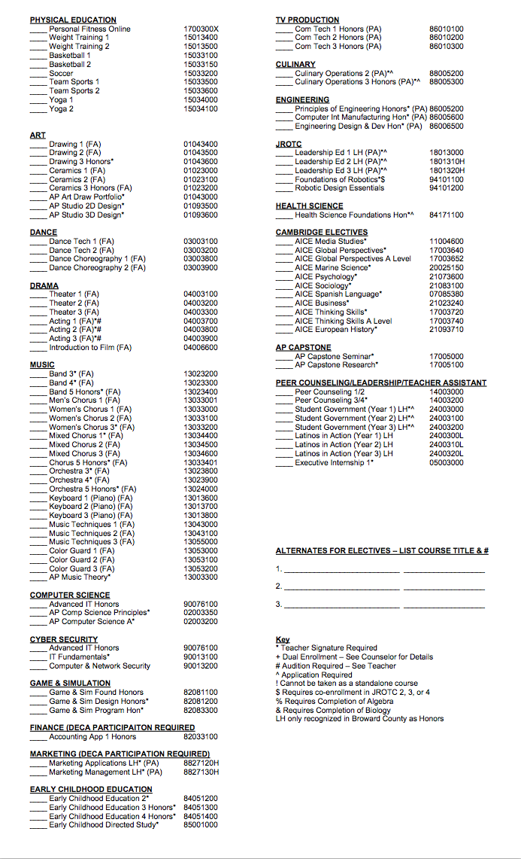
11th Grade Course Card – Example

Slide 15
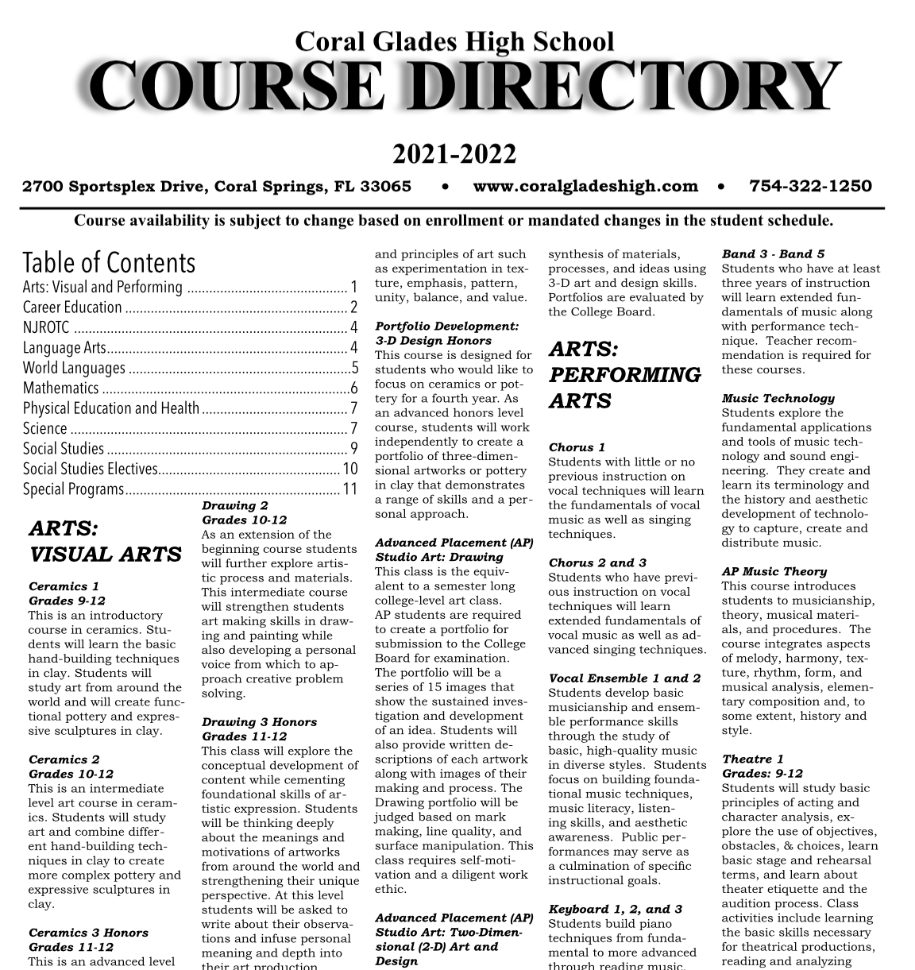
Course Directory

Slide 16
Additional Information and Dates
April 2021: School Counseling presentations in Study Halls for end-of-the-year reminders
May 1, 2021: Deadline to submit summer BVS course requests
Mid May: Advanced Academics student meeting with Ms. Plass
June 8, 2021: Deadline to request a schedule change

